Slide 1
Results for Three Strategies
Chris Liang

Slide 2
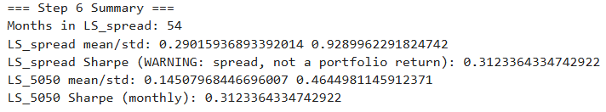
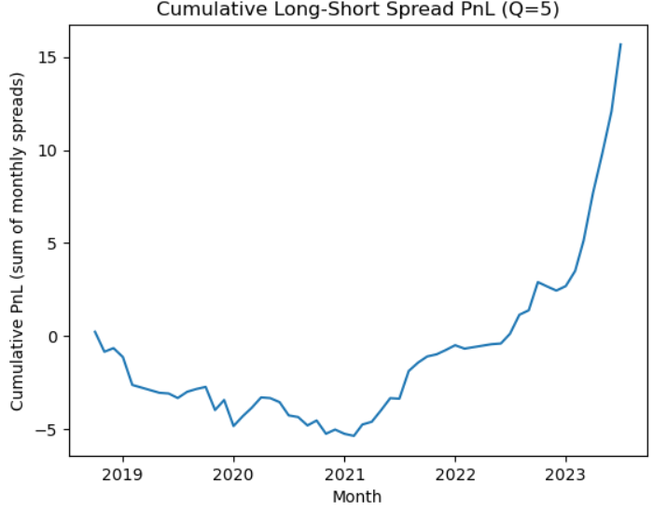
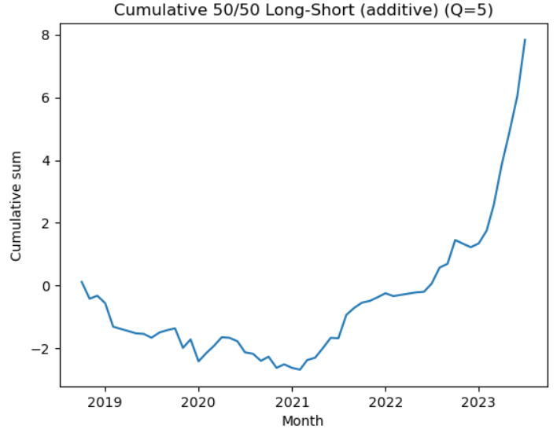
Strategy 1 Step 6

Slide 3
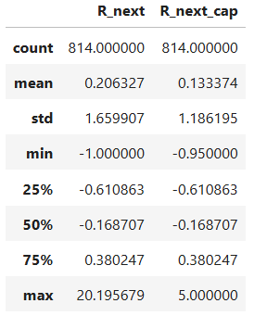
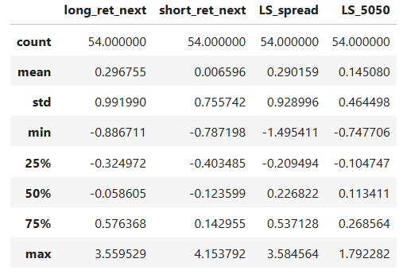
Strategy 1 Step 7
# long_ret_next: Month-t "winner" leg return realized in month t+1 (average R_next_cap of the long side / top group)
# short_ret_next: Month-t "loser" leg return realized in month t+1 (average R_next_cap of the short side / bottom group)
# LS_spread: Long-minus-short spread = long_ret_next - short_ret_next (notional spread, not 50/50 scaled)
# LS_5050: 50/50 self-financing long-short return = 0.5 * (long_ret_next - short_ret_next)
# R_next: Per-asset next-month realized return (for each permno in membership), i.e., R_{t+1} aligned to signal month t
# R_next_cap: Capped/winsorized version of R_next (e.g., clipped to [CAP_LO, CAP_HI]) to reduce outlier influence

Slide 4
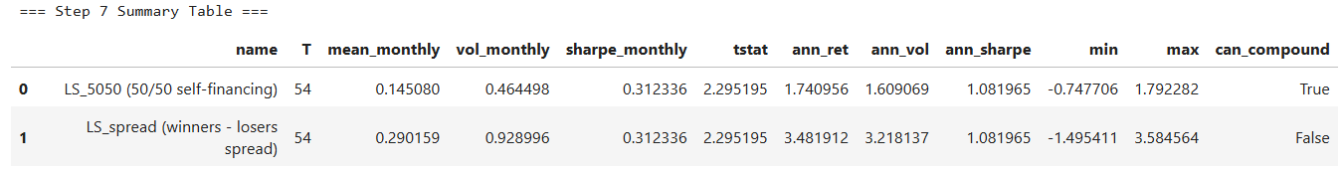
Strategy 1 Step 7
T # number of valid observations (months)
mean_m # average monthly return
vol_m # monthly volatility: sample standard deviation (ddof=1)
sharpe_m # monthly Sharpe ratio (rf assumed 0); NaN if vol=0
tstat # t-stat of mean return vs 0
ann_ret # annualized return via linear scaling (12 * monthly mean)
ann_vol # annualized volatility via sqrt-time scaling (sqrt(12) * monthly std)
ann_sharpe # annualized Sharpe ratio
can_compound # True if all months satisfy (1+R)>0 so cumprod is valid

Slide 5
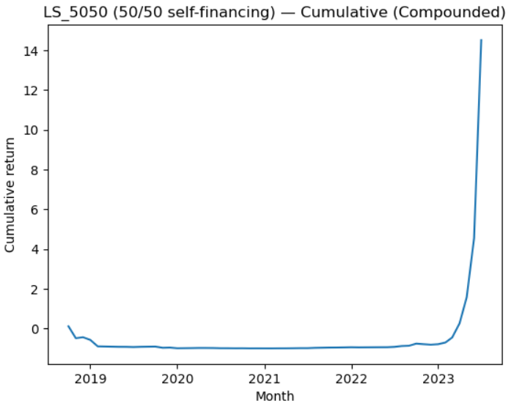
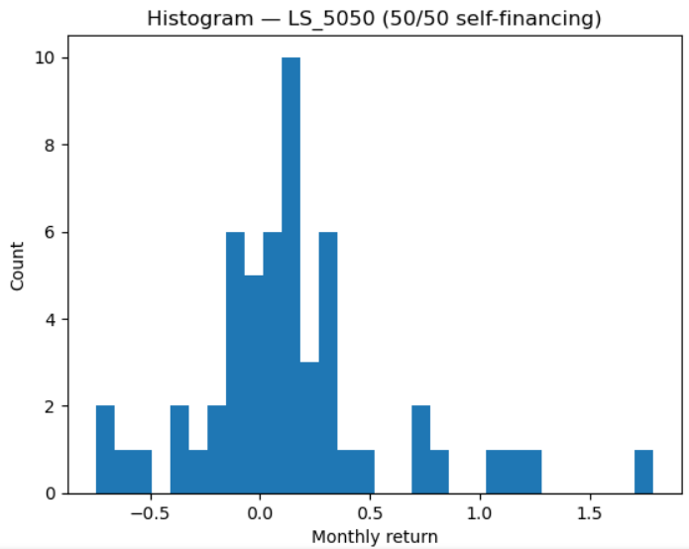
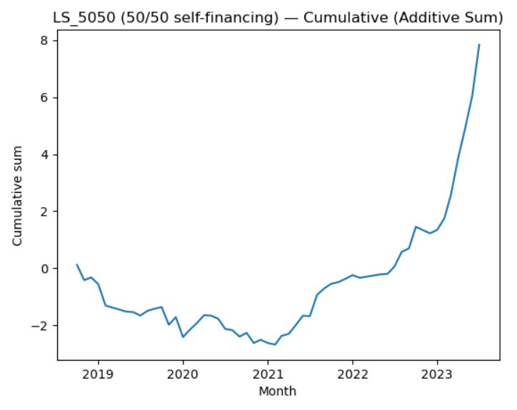
Strategy 1 Step 7
- LS_5050: the monthly return of a self-financing long–short portfolio that goes 50% long the “winner” group and 50% short the “loser” group; numerically LS_5050(t) = 0.5 * (R_winner(t+1) - R_loser(t+1)).
- Cumulative (Compounded): plots the growth of $1 invested in LS_5050 using geometric compounding, i.e., cumulative = (∏_{τ≤t} (1 + LS_5050(τ))) - 1.
- Histogram: shows the distribution of monthly LS_5050 returns (how often different return levels occur).
- Cumulative (Additive Sum): plots the running sum of LS_5050 returns, i.e., cumulative = Σ_{τ≤t} LS_5050(τ), which is an additive PnL-style accumulation (not a wealth curve).

Slide 6
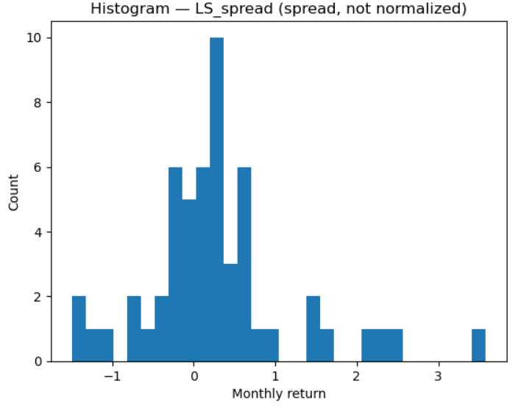
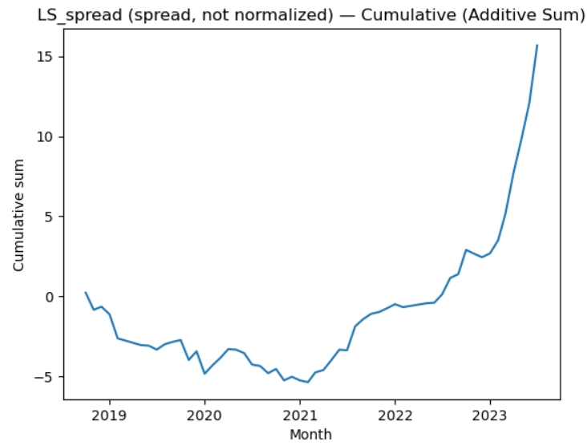
Strategy 1 Step 7
# LS_spread: the raw (not self-financing / not normalized) long–short return spread each month, defined as LS_spread(t) = R_winner(t+1) - R_loser(t+1); it measures how much the winner group outperformed the loser group in that next month.

Slide 7
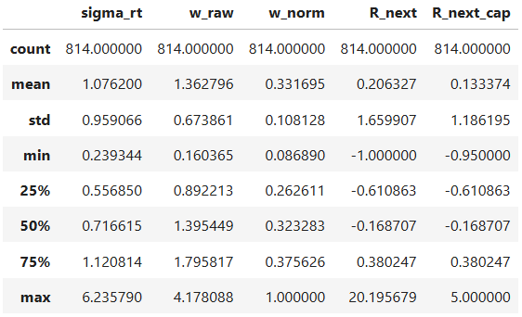
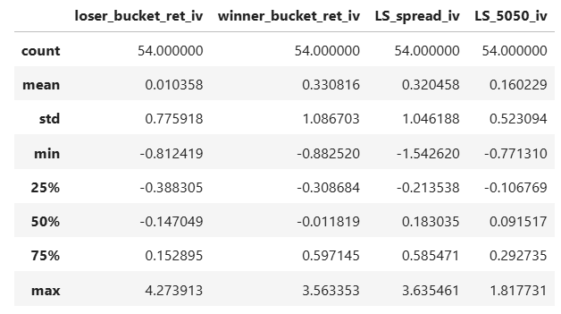
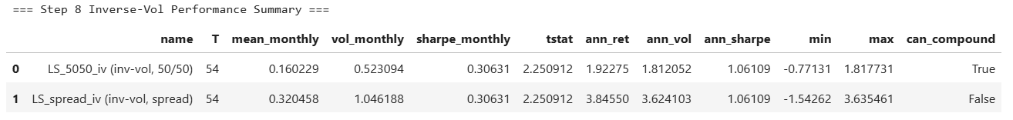
Strategy 1 Step 8

Slide 8
Strategy 1 Step 8
# sigma_rt: realized volatility estimate for that permno at signal month t (std of past returns R_t1 over t-12..t-2 via shift(2).rolling(11).std).
# w_raw: raw inverse-vol weight before normalization; typically w_raw = 1 / (sigma_rt + eps) (higher weight for lower volatility names).
# w_norm: normalized weight within the bucket (and month) so weights sum to 1 across names in the same (month, bucket).
# R_next : the realized next-month return for that permno (i.e., return from month t to t+1).
# R_next_cap: winsorized/capped version of R_next (e.g., clipped to [CAP_LO, CAP_HI]) to reduce the influence of extreme outliers.
# --- Month-level IV bucket + long-short outputs (row = one month t; bucket returns are evaluated using t+1 realized returns) ---
# loser_bucket_ret_iv: inverse-vol-weighted return of the loser bucket (bucket 1) for that month, using weights within the loser bucket.
# winner_bucket_ret_iv: inverse-vol-weighted return of the winner bucket (bucket Q) for that month, using weights within the winner bucket.
# LS_spread_iv: long-short spread return for that month = winner_bucket_ret_iv - loser_bucket_ret_iv (raw spread, not normalized).
# LS_5050_iv: 50/50 self-financing long-short return for that month = 0.5 * (winner_bucket_ret_iv - loser_bucket_ret_iv).
# name: label for the return series being evaluated.
# T: number of non-NaN monthly observations in the series.
# mean_monthly: average monthly return of the series.
# vol_monthly: monthly return volatility (sample std, ddof=1).
# sharpe_monthly: mean_monthly / vol_monthly (risk-free assumed 0).
# tstat: t-statistic for testing mean_monthly = 0 (mean / (vol/sqrt(T))).
# ann_ret: annualized mean return (12 * mean_monthly; linear scaling).
# ann_vol: annualized volatility (sqrt(12) * vol_monthly).
# ann_sharpe: annualized Sharpe = ann_ret / ann_vol (equivalently sharpe_monthly * sqrt(12)).
# min: worst single-month return observed in the series.
# max: best single-month return observed in the series.
# can_compound: True iff (1 + R_t) > 0 for all months in the series (required for a valid compounded wealth curve).

Slide 9
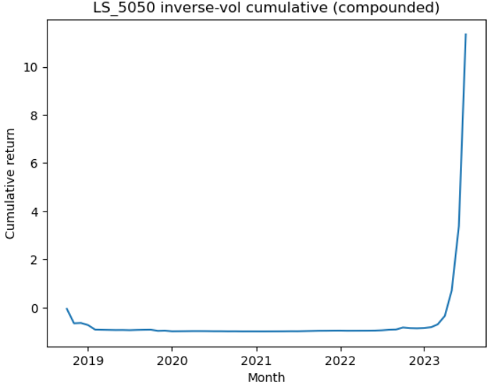
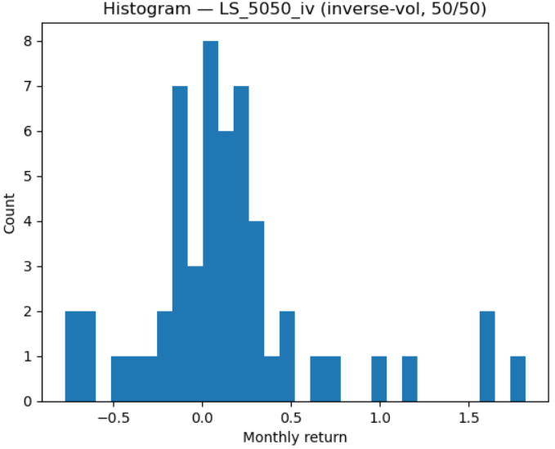
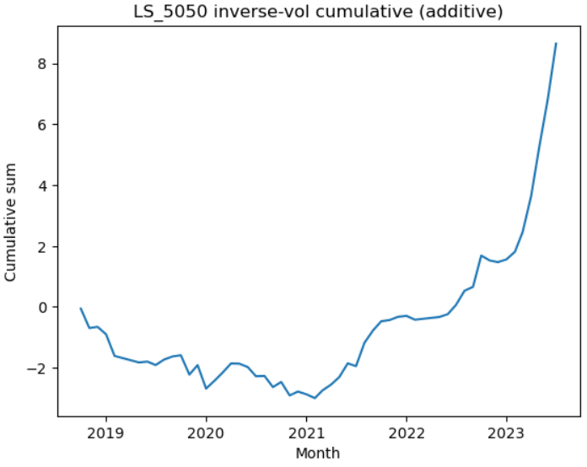
Strategy 1 Step 8

Slide 10
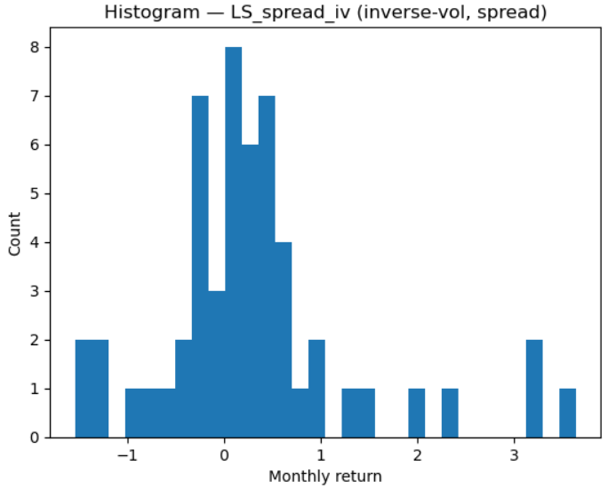
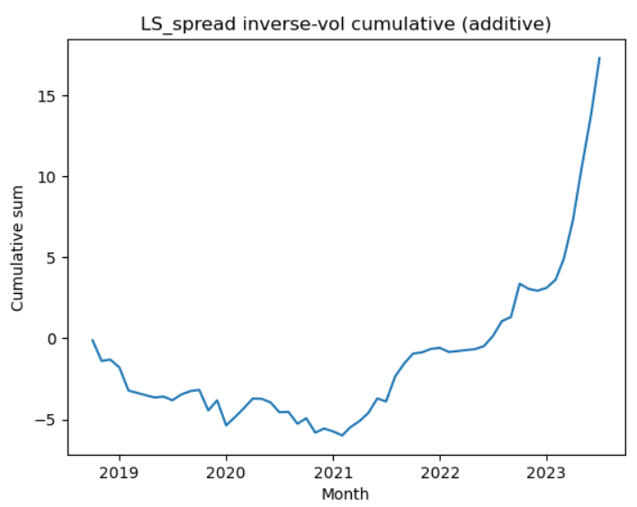
Strategy 1 Step 8

Slide 11
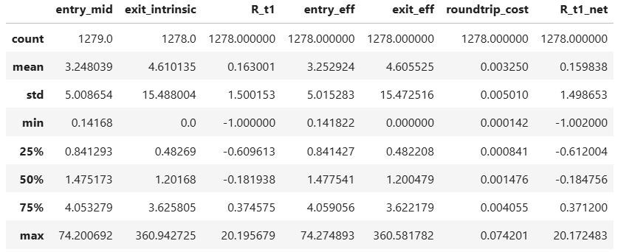
Strategy 1 Step 9
# entry_mid: entry premium at formation (delta-weighted call/put mids); baseline “gross” entry price.
# exit_intrinsic: intrinsic value at expiry (delta-weighted call/put intrinsic payoffs); baseline “gross” exit value if held.
# R_t1: gross return = (exit_intrinsic - entry_mid) / entry_mid.
# entry_eff: effective entry execution price after entry slippage (pay worse than mid), e.g., entry_mid*(1+slip).
# exit_eff: effective exit value after exit haircut/slippage (receive worse than intrinsic), e.g., exit_intrinsic*(1-exit_cost).
# roundtrip_cost: additional round-trip transaction cost modeled as % of entry_mid (e.g., bps per leg × #legs).
# R_t1_net: net return after slippage + costs = (exit_eff - entry_eff - roundtrip_cost) / entry_mid.

Slide 12
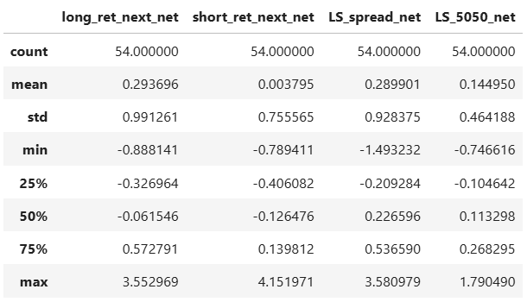
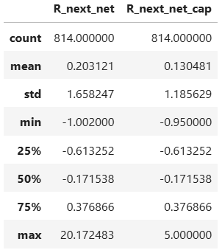
Strategy 1 Step 9

Slide 13
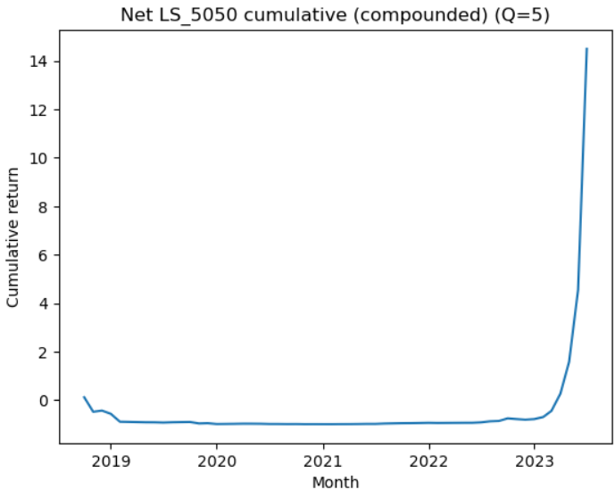
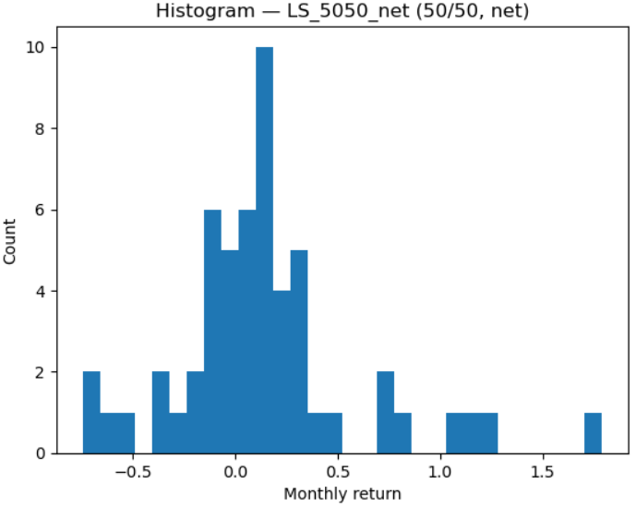
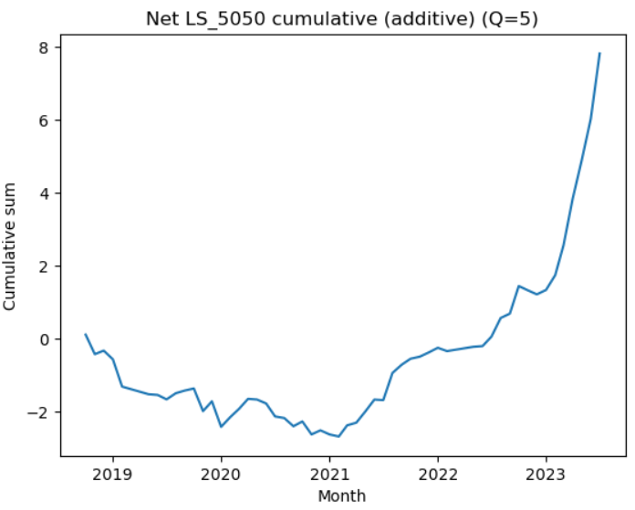
Strategy 1 Step 9

Slide 14

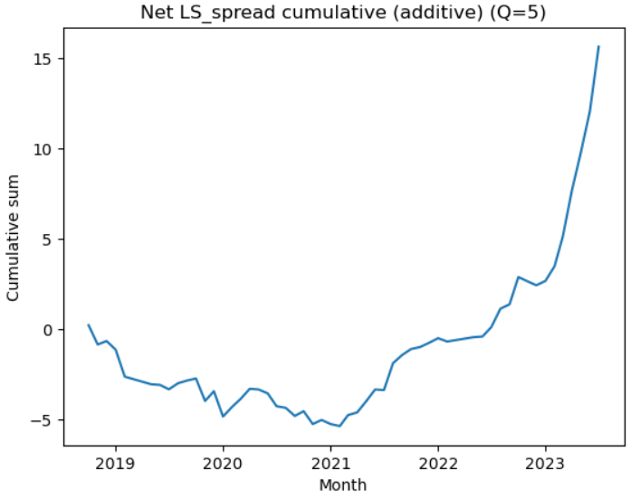
Strategy 1 Step 9

Slide 15
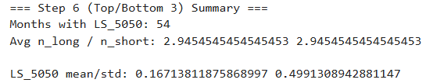
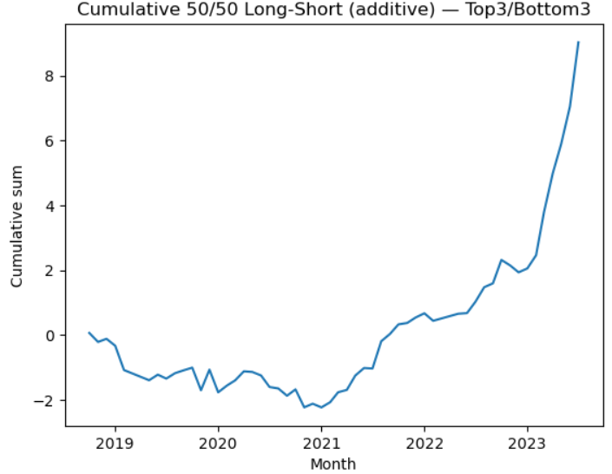
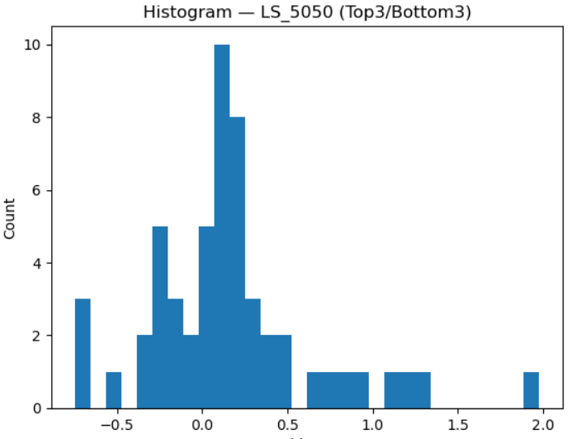
Strategy 2 Step 6

Slide 16
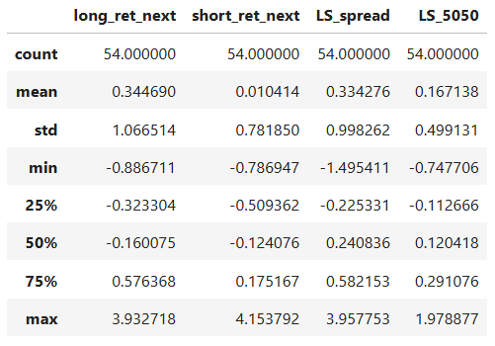
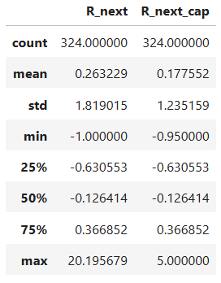
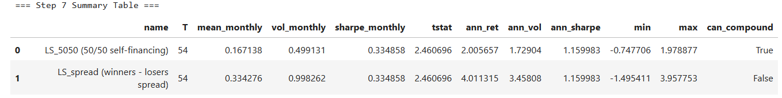
Strategy 2 Step 7

Slide 17
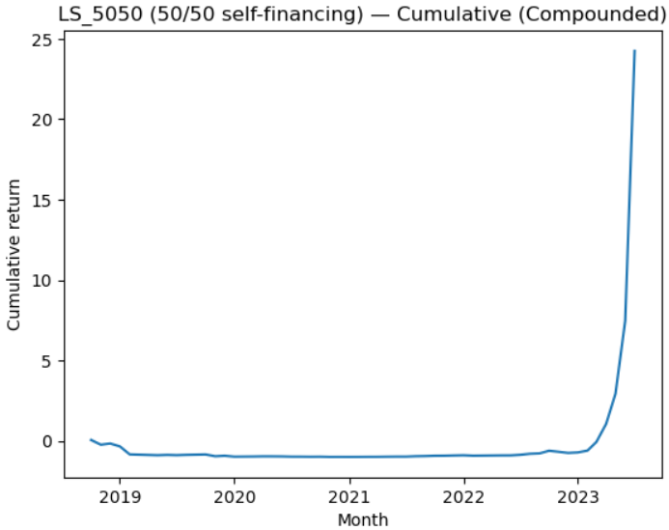
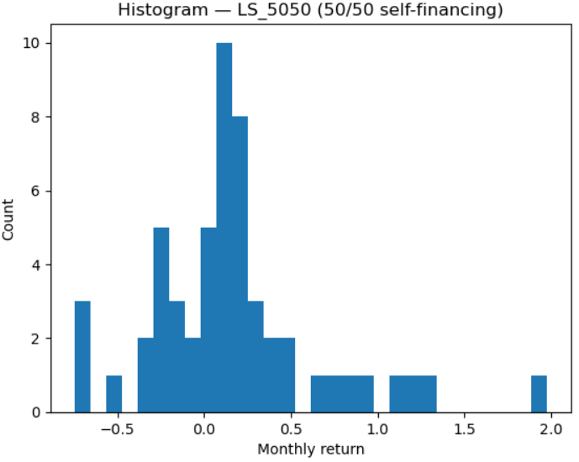
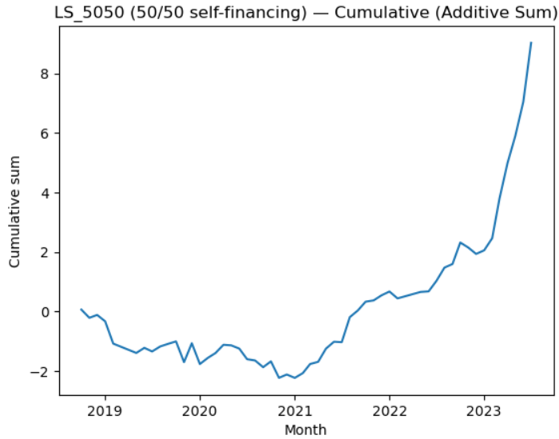
Strategy 2 Step 7

Slide 18
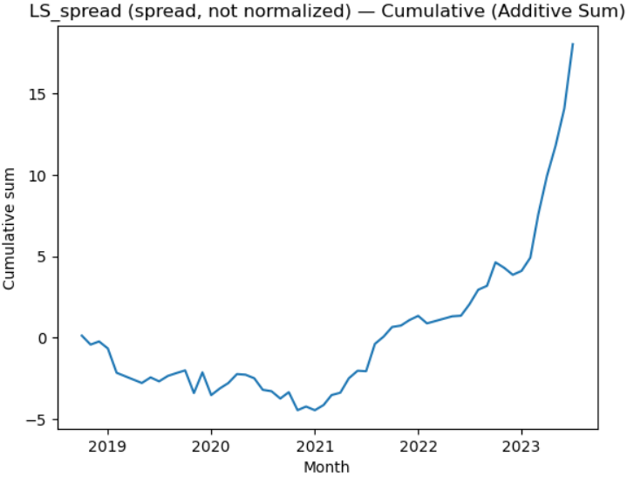

Strategy 2 Step 7

Slide 19
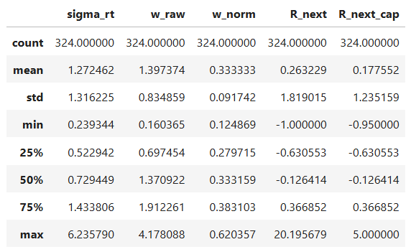
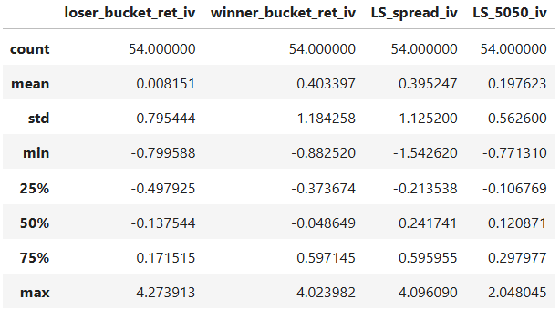
Strategy 2 Step 8

Slide 20
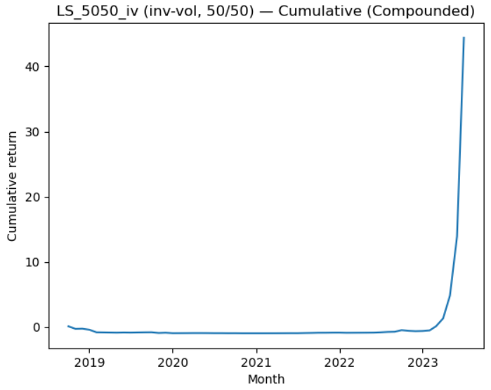
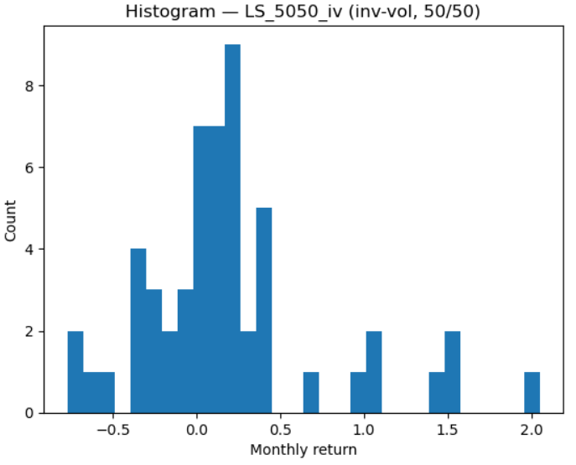
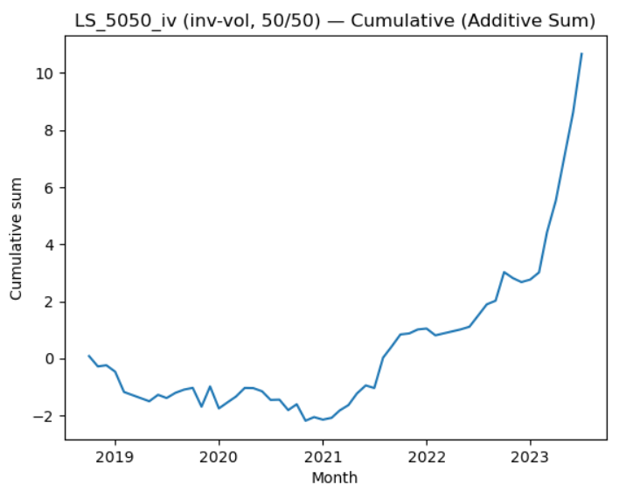
Strategy 2 Step 8

Slide 21
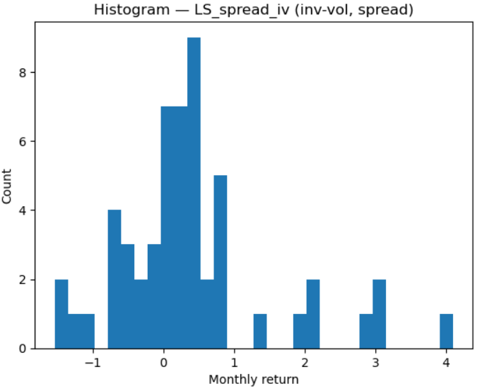
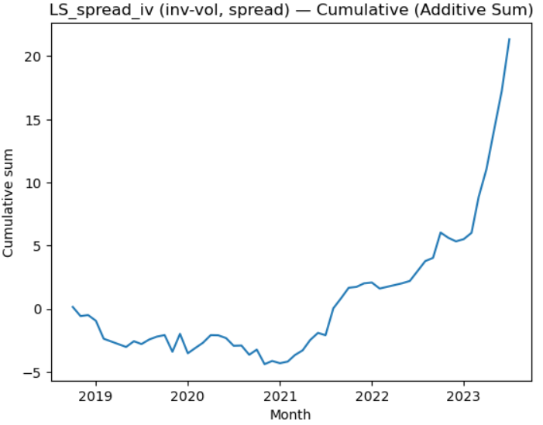
Strategy 2 Step 8

Slide 22
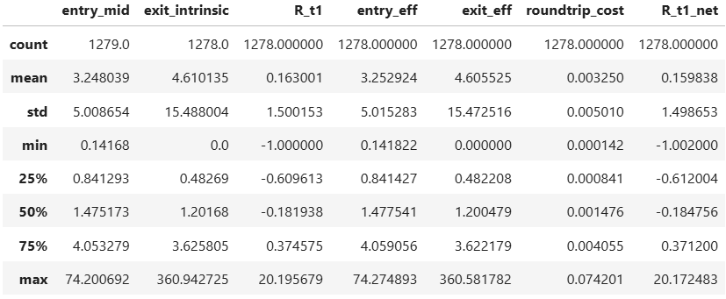
Strategy 2 Step 9

Slide 23
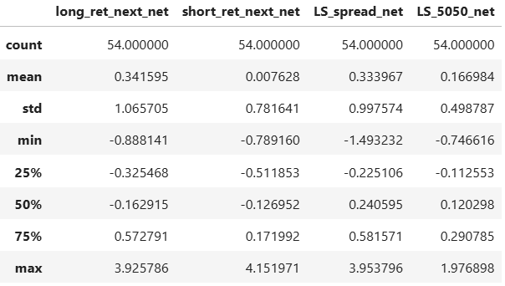
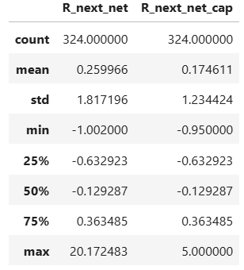
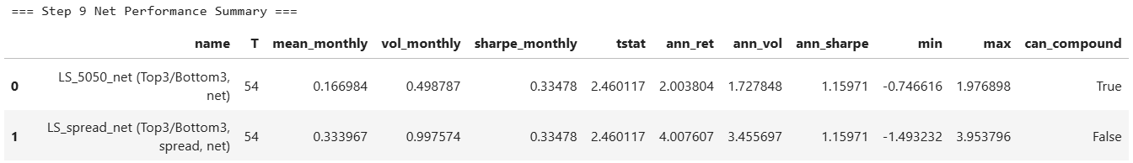
Strategy 2 Step 9

Slide 24
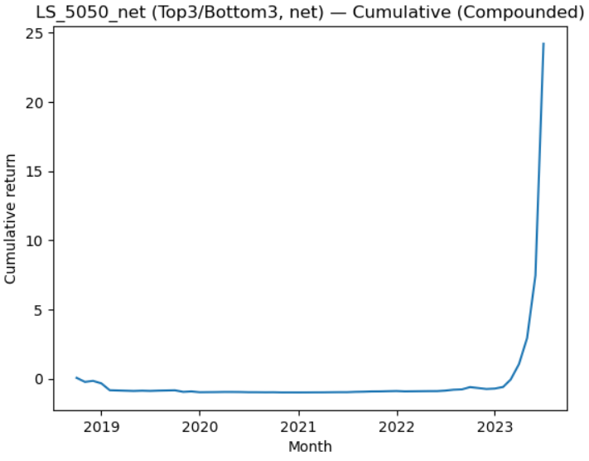
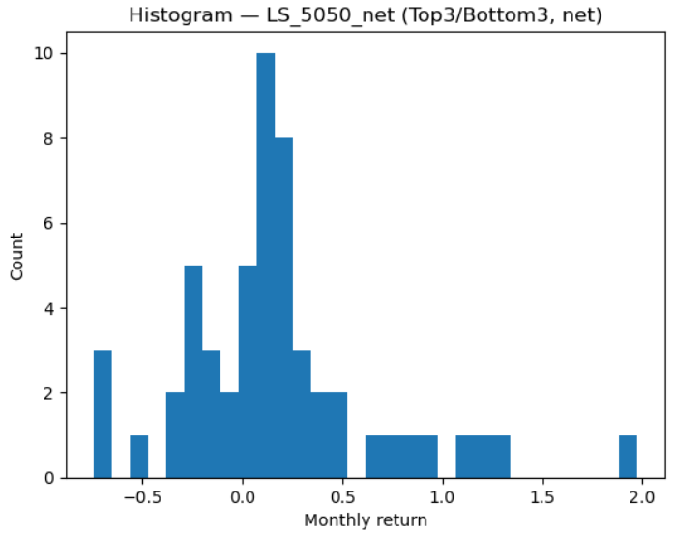
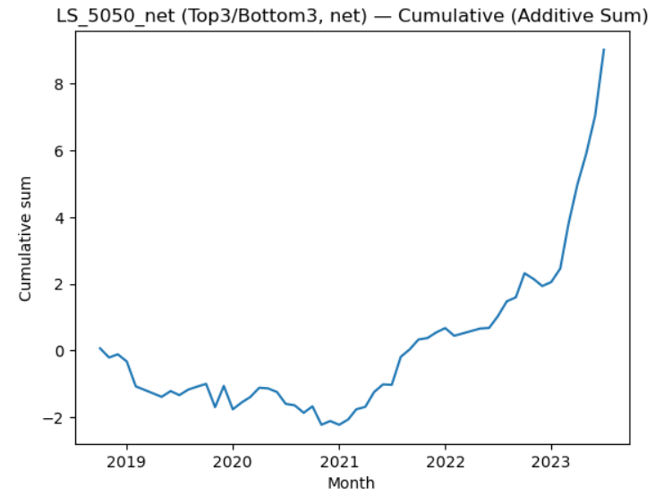
Strategy 2 Step 9

Slide 25


Strategy 2 Step 9

Slide 26


Strategy 3 Step 6

Slide 27



Strategy 3 Step 7

Slide 28



Strategy 3 Step 7

Slide 29


Strategy 3 Step 7

Slide 30



Strategy 3 Step 8

Slide 31



Strategy 3 Step 8

Slide 32



Strategy 3 Step 8

Slide 33

Strategy 3 Step 9

Slide 34



Strategy 3 Step 9

Slide 35



Strategy 3 Step 9

Slide 36


Strategy 3 Step 9

Slide 37






Strategy 1 to 3 Step 5

